Slide 1
Monkey
GTG

Slide 2
Contents
Problem statement
Solution
Impact

Slide 3
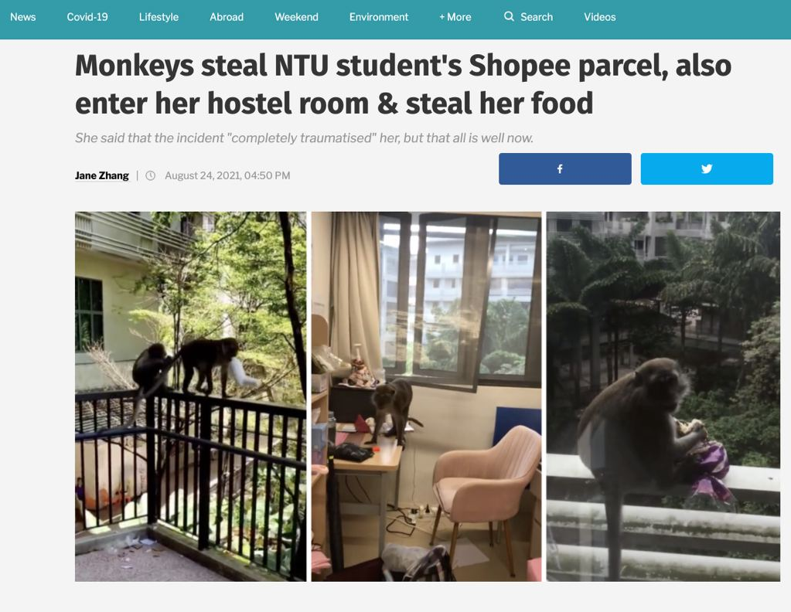
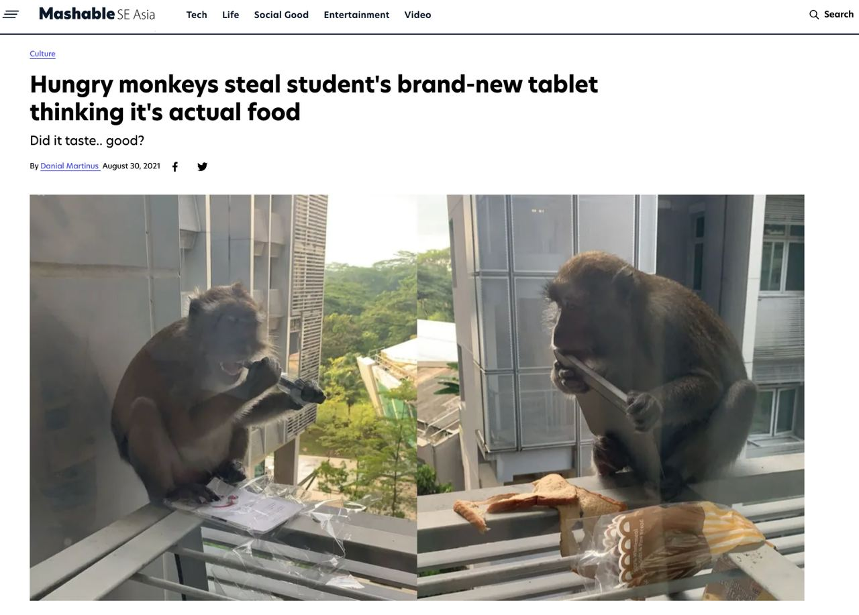
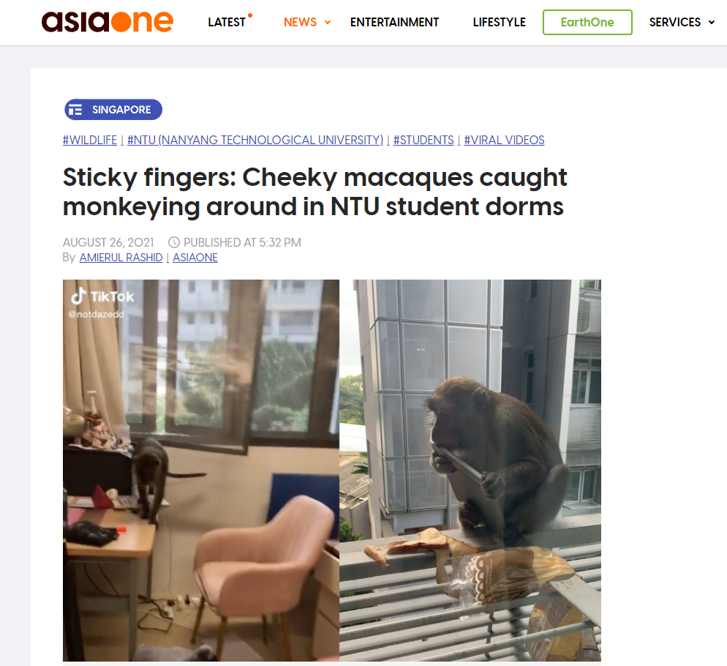
Problem statement

Slide 4
730
4
12000
Students in a Monkey Watch telegram group
Sightings per day on average
Students potentially affected across 24 halls

Slide 5
Monkey GTG
Comprehensive solution to all “monkey business”!

Slide 6
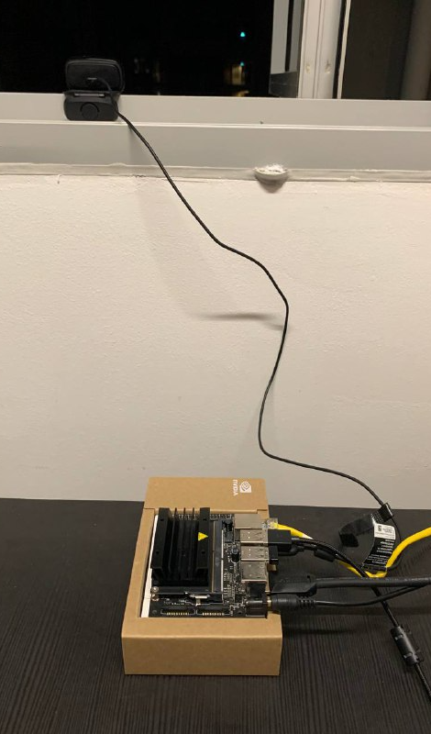
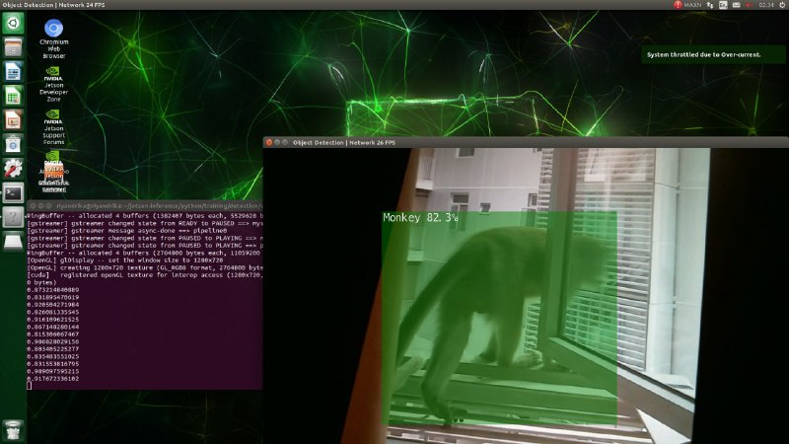
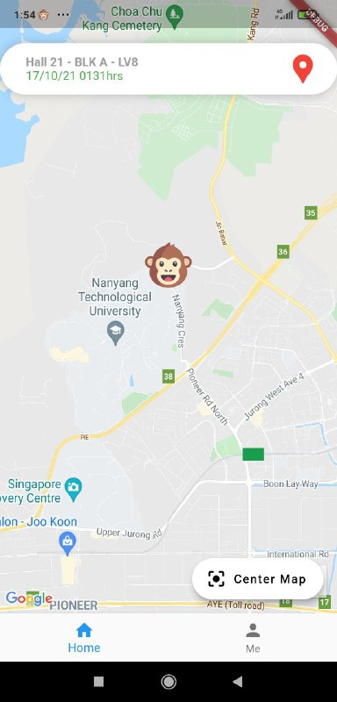
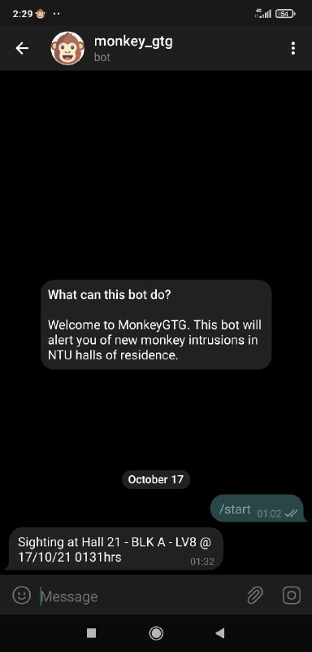




How it works
Detect
Alert
Monkeys at the windows
User through our pairing app
Alarm
Notify
Scare them away with a high frequency emitter
Student community through Telegram

Slide 7
Features
Compact
Reliable
A camera, micro-controller and emitter is all you need!
AI-powered monkey detection
Communal
Convenient
Real-time updates with a mobile app and telegram bot
Automatically scares away monkeys without manual input

Slide 8
Impact
No more parcels or iPads stolen by monkeys
Sense of security and ease (even when you’re not in hall)
Help notify the broader NTU community

Slide 9


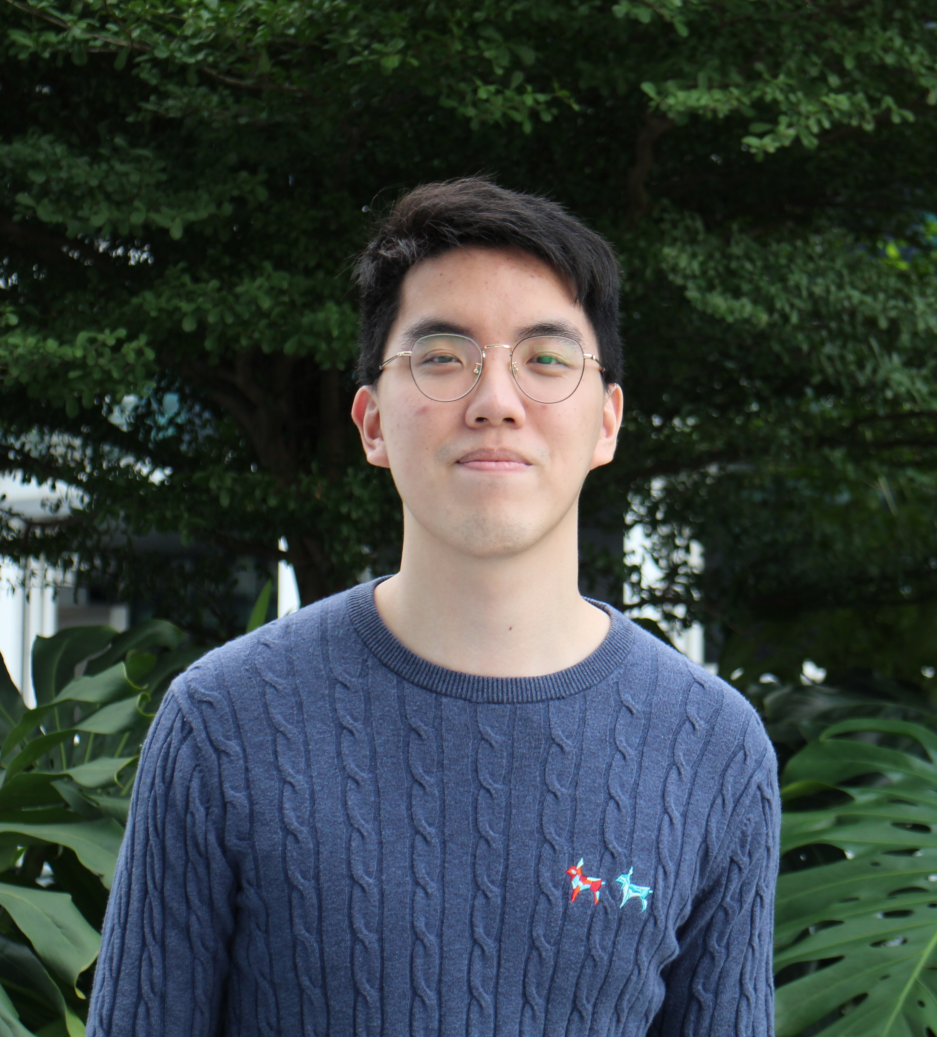
The Team
Ray Gao Xin Rui
Riyan Andrika
Ng Jun Yi
REP (CS) Year 3
REP (EEE) Year 3
MAE Year 4

